Slide 1
Sustainable community investment in action
A look at some of the R Consortium Funded Grant Projects and Working Groups
Joseph B Rickert
R Consortium Director

Slide 2
R Consortium Momentum
3 years since launch | $650k+ Grant dollars awarded | 28 Supported Projects | 8 Launched Working Groups
150+ Sponsored R Meetups | 15+ Supported R Community Events | 40k+ R users members of supported meetups | 3 useR! events sponsored

Slide 3
New 2018 Projects

Slide 4
DBI Project - Kirill Müller
DBI, R's database interface, is a set of methods declared in the DBI R package.
Communication with the database is implemented by DBI backends, packages that import DBI and implement its methods.
A common interface is helpful for both users and backend implementers.
The "Maintaining DBI" is a follow-up project is mostly about providing ongoing maintenance and support for:
DBI
The DBItest test suite
The three backends to open-source databases
RSQLite,
RMariaDB
RPostgres

Slide 5
Infrastructure Development - Jeroen Ooms
This project seeks to improve and maintain tools for providing binaries
On Windows: upgrade the Rtools compiler toolchain, and provide up-to-date Windows builds for the many external C/C++ libraries used by CRAN packages
For MacOS: expand the r-hub "homebrew-cran" tap with formulas that are needed by CRAN packages but not available from upstream homebrew-core
Eventually: lay the foundation for a reproducible build system that is low maintenance, automated as much as possible

Slide 6
Tools and Templates for Teaching Materials - François Michonneau
This project will develop tools to facilitate the development of consistent teaching resources
Provide a technical framework to encourage collaborative lesson development
Teaching tools will be constructed from the many R resources for literate programming including:
Sweave
knitr
Rmarkdown

Slide 7
PSI Collaboration Project - Lyn Taylor (on behalf of PSI AIMS SIG)
Statisticians from the Pharmaceutical Industry (PSI) Application and Implementation of Methodologies in Statistics (AIMS) Special Interest Group (SIG) will collaborate with the R-Consortium and representatives from pharmaceutical companies to set up of an online repository.
The repository will:
Provide the tools to conduct the regulatory standard validation for R packages
Serve as a portal for sharing existing regulatory standard validation documentation
Store packages and make them freely available
Companies (or individual R users) would still need to make their own assessment on whether the validation is suitable for their own use

Slide 8
A Unified Platform for Missing Values – Julie Josse and Nick Tierney
The objective is to create a reference platform the management of missing data management that will facilitate collaboration
The platform will:
List the existing packages, the available literature and tutorials
Provide a platform for integrating new work on the subject
Contain examples of analysis workflows

Slide 9
histoRicalg – A Project to Preserve and Transfer Algorithmic Knowledge - John C Nash
Many of the algorithms underlying R code were written several decades ago in languages such as Fortran and C in which only a modest proportion of R users are fluent.
Many original authors are no longer active.
The histoRicalg project aims to:
Document and test codes older non-R code that are still part of R
Possibly creating all-R reference codes
Teaming older and younger workers Facilitate knowledge transfer
The initial task is to establish a working group on Algorithms Used in R
See https://gitlab.com/nashjc/histoRicalg

Slide 10
Working Group on US Census Data – Ari Lamstein
The working group aims to make life easier for R programmers who work with data from the US Census Bureau
The Census Data working group will:
Operate as a forum for working with census data under the guidance of the Census Bureau.
Facilitate cooperation
Publish a guide to working with Census data in R
Help R programmers
select packages that meet their needs
navigate the various Census Bureau datasets

Slide 11
Top Level Projects

Slide 12
RC RUGS 2018 Sponsorship Program
10 Conferences
94 User Groups
$39k in Grants

Slide 13
75 + R-Ladies Groups Worldwide

Slide 14
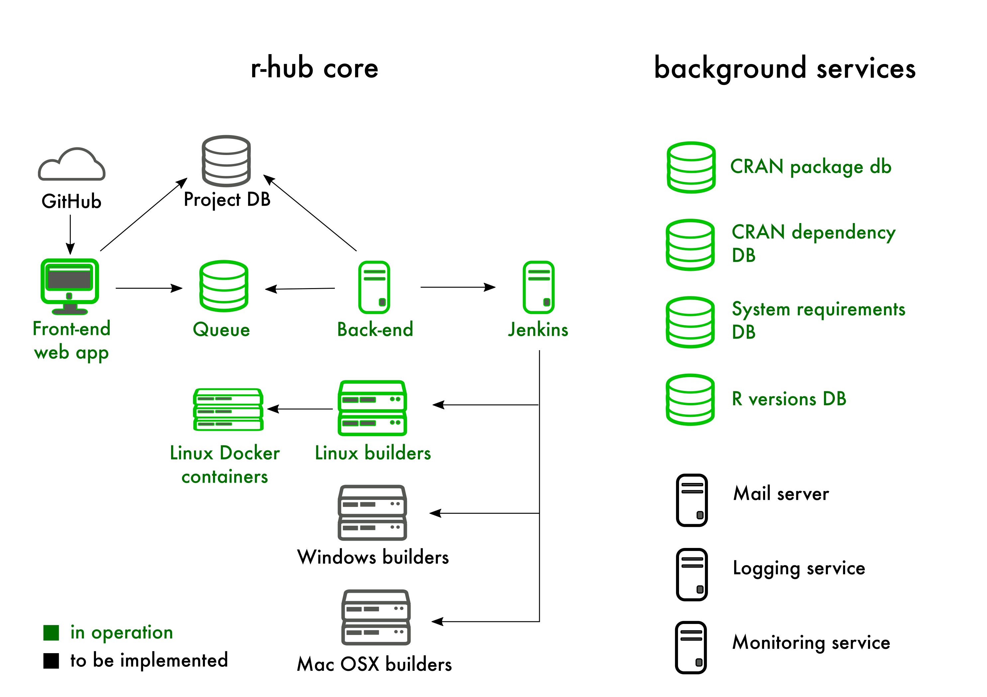
R-Hub
A service for:
Developing, building, testing and validating R packages
Simplifying the R package development process
https://builder.r-hub.io/

Slide 15
Working Groups

Slide 16
Active ISC Working Groups
Future-proof native APIs for R: This working groups will assess current native API usage, gather community input, and work towards an easy-to-understand, consistent and verifiable API that will drive R language adoption.
Code Coverage Tool for R: Helping to improve software quality, the code coverage tool will address feature and platform limitations of existing tools while also promoting the use of code coverage more systematically within the R ecosystem.
A Unified Framework for Distributed Computing in R: Develop a common framework to simplify and standardize how users program distributed applications in R
R Certification: Working to establish a common certification program for proficiency in R
R in Medicine: A community of R users in the medical industry collaborating on events and advocacy of R.
R in Pharma: A community of R users in the pharmaceutical industry collaborating on events and advocacy of R.
R Community Diversity and Inclusion Working Group: A group broadly consider how the R Consortium can best encourage and support diverse and inclusion in the R Community
Working Group on US Census Data: a forum for working with census data under the guidance of the Census Bureau.

Slide 17
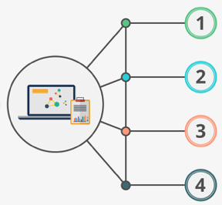
Get Involved!!
Visit R Consortium website
https://www.r-consortium.org/
Learn about ISC funded and sponsored work
https://www.r-consortium.org/projects/
Learn about the RUGS program
https://www.r-consortium.org/projects/r-user-group-support-program
Ask your company to join the R Consortium
https://www.r-consortium.org/about/join

